Slide 1
Health insurance market place
Team 7
Fei Shen
Dongqi Guo
Yaohua Song

Slide 2
Outlines
Introduction
Dataset analysis
Approach
Data cleansing
ANN
  R
  Python
Conclusion
Q&A

Slide 3
Introduction
Health Insurance:
Premium Rate
Deductibles
Out-of-Pocket Money (MOOP)
Demographic information:
Age
Location
Marriage status
depdents

Slide 4
Dataset outline
Dataset download from Kaggle: https://www.kaggle.com/hhs/health-insurance-marketplace
Contains 2014, 2015, 2016 health insurance market place.
Rate: contains users demographic info: age, location, married, tobacco use, and dependents.
Plan Attributes: each plan’s attributes.
We focuses on health insurance plan’s deductibles, MOOP.
Analysis: Individual Premium rates, demographic info, deductibles, and MOOP’s information.

Slide 5
Three MapReduce programs are used to display the rate: rate by year, age range, and alternative tobacco rate.
The data visualization are shown in the website. http://104.196.196.243:8080/bigdatafinal/

Slide 6
Approach
Analyze data, determine relationships between attributes.
Data cleansing (MapReduce) to extract useful information from dataset.
Data visualization (MapReduce)
ANN:
  R: linear regression
  Python: ANN with
Apply weights to website to predict premium rates based on their entered information.

Slide 7
Data cleansing
Hadoop MapReduce:
Rate.Csv: extract rate for individual and group rates. If users has a tobacco preference, uses the tobacco individual rate alternatively If users are has a family option, enter the married status and dependent status. Map: process files and reduce get rid of duplicated value.
Attributes.csv: extract deductibles (Combined, Tier1, OutOfNetwork), MOOP(Combined, Tier1, OutofNetwork), MetalLevel for drug-only plan, medical-only plan, combined plan, and dental-only plan for each individual. Use practitioner to put results file in different bin.
R: processing Hadoop processed csv file into R-supported format. Join plan attributes files with plan Id, and get ride of the unused column.
Observation around 12, 000, 000, with 10 variables for neural network.

Slide 8
R
MISSING VALUE: -> 0
Consider age as numeric values, and change location and metal level from categorical to numeric value.
PCA for numeric deductibles and MOOP value: Combined deductibles and combined MOOP has the most components. However, some plans don’t has this combined parts, so we considering all deductibles and MOOP.
Linear Regression:
  Min_max_accuracy: 81.36%, mean squared error: 12.56

Slide 9
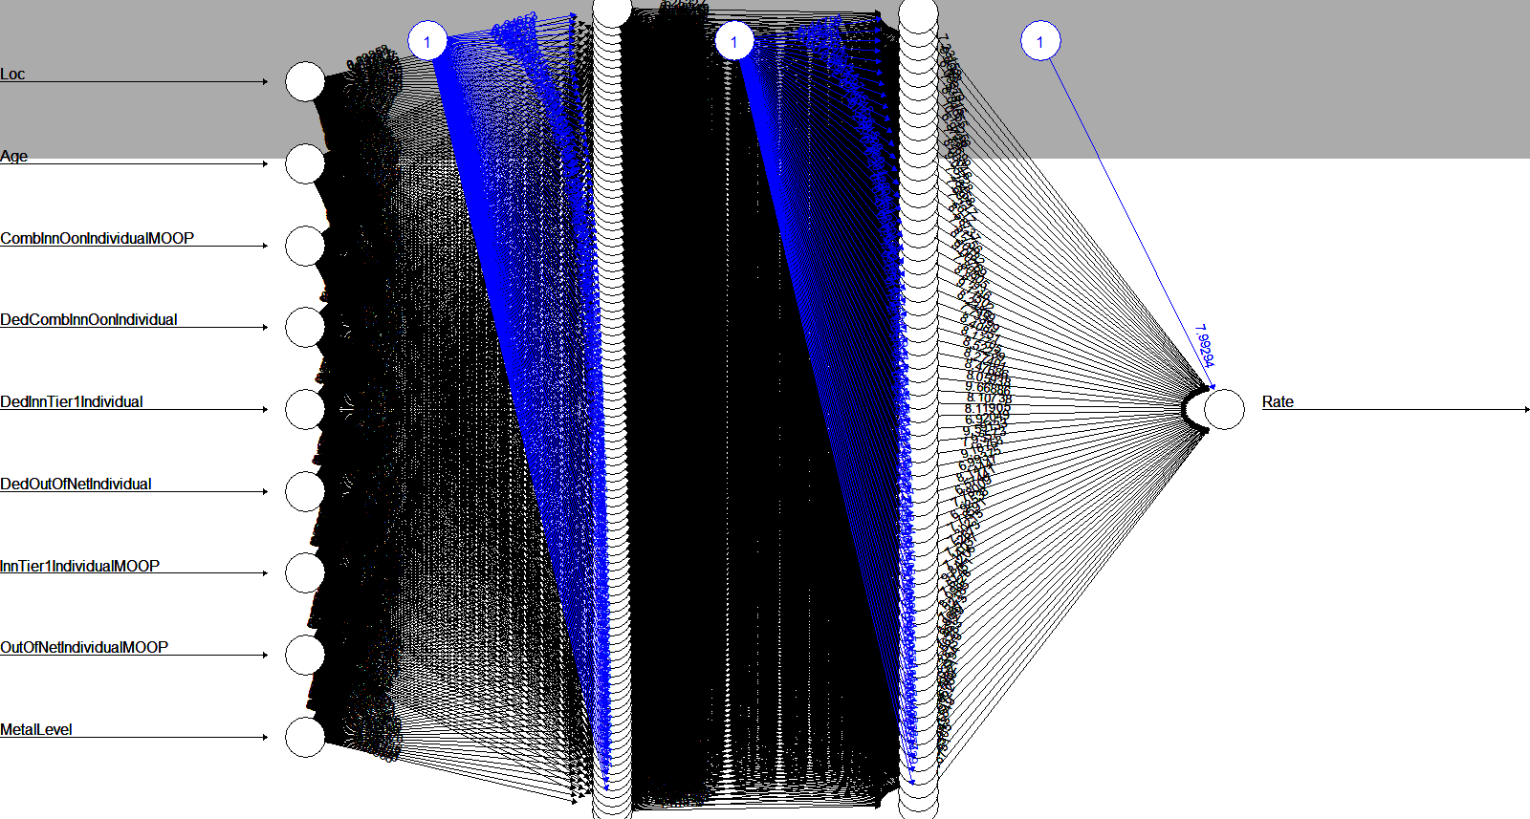
R Cont
ANN – neuralnet package
  Divide data into train and test set (80%:20%)
  Convert categorical into numeric value, using model.matrix function
  Build a neuron network hidden layer of 100, 60, threshold = 0.1
  Predict data using test dataset
  The mean squared error is around 8. lower than linear regression

Slide 10
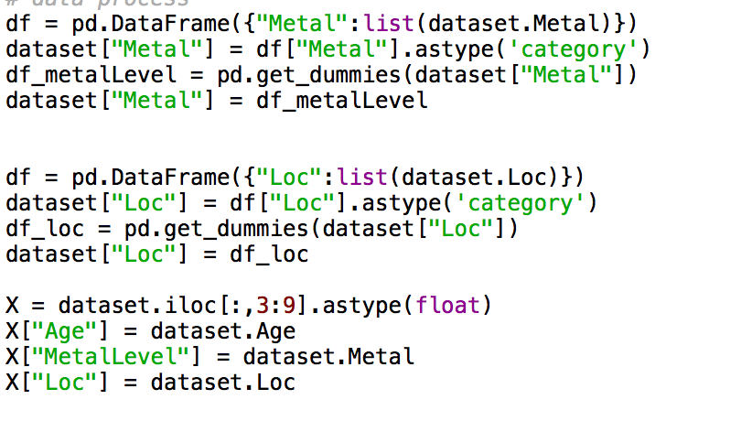
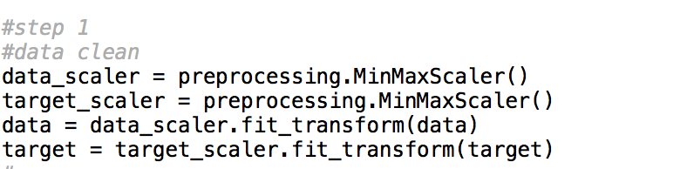
Python machine learning
Data cleaning

Slide 11
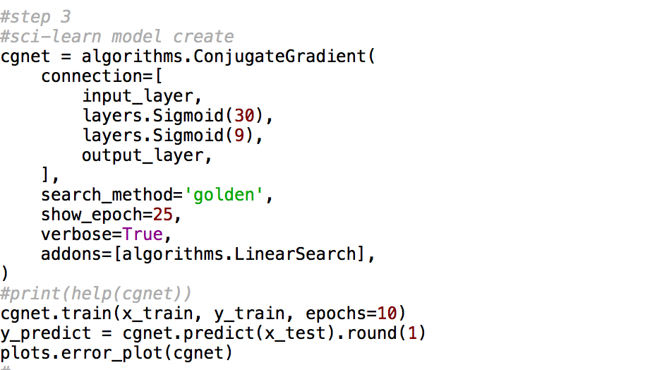
ANN
Python: NeuPy – a python neuron network built on Theano and Pandas.

Slide 12
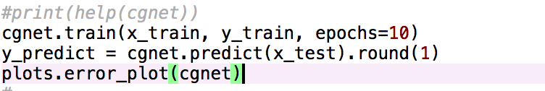
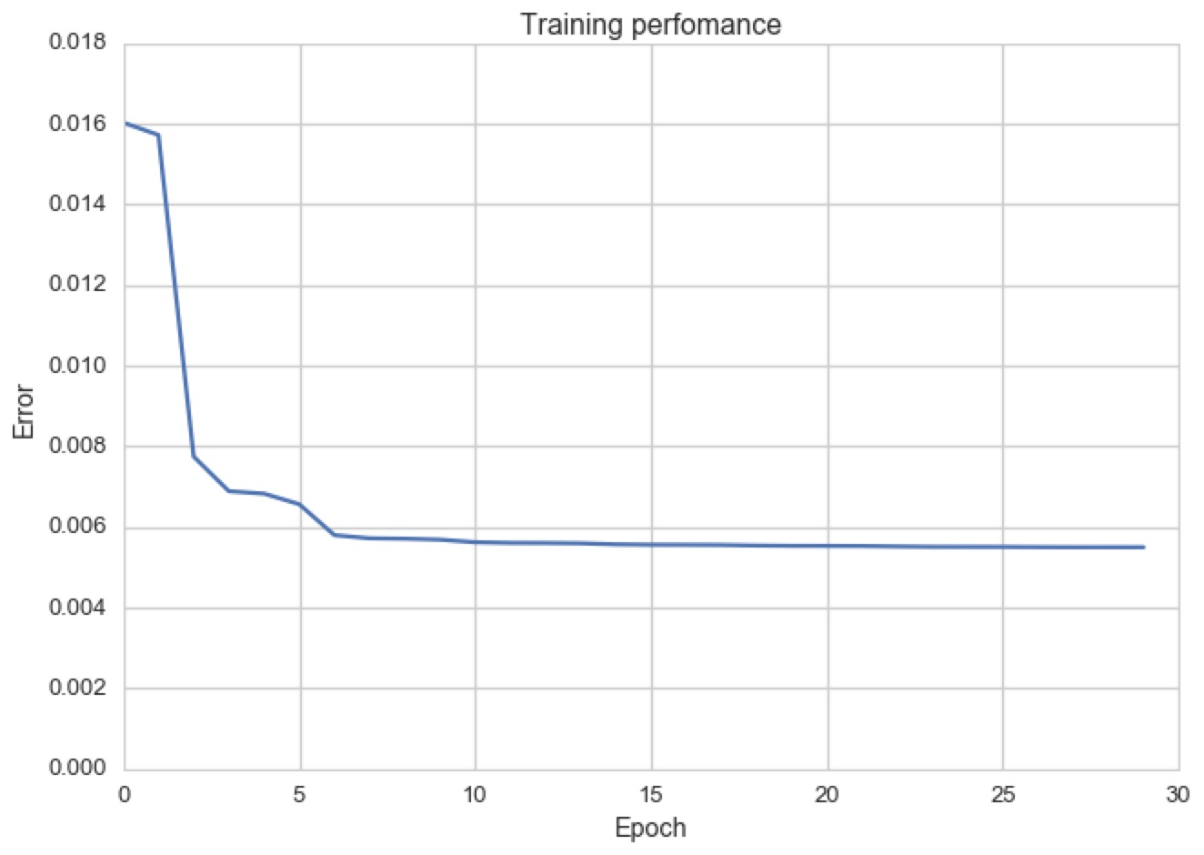
Python Cont
One hidden layer of 30 neuron, repeated for 30 times.
Error (root-mean-squared-log: 0. 47 mean-squared-log around 4

Slide 13
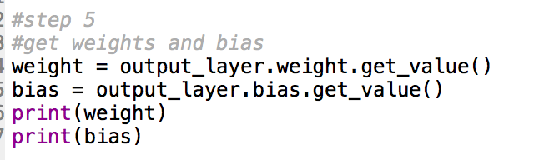
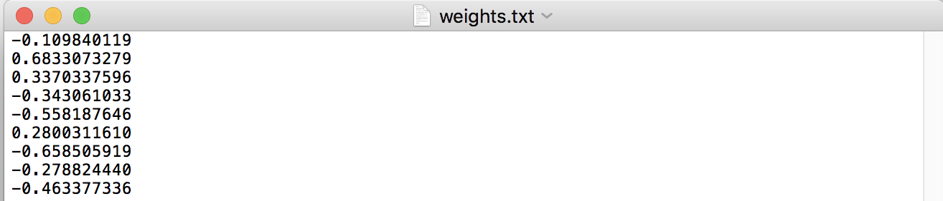
Use Case
Predict premium rate based on user input
http://104.196.196.243:8080/bigdatafinal/

Slide 14

Q&A

Slide 15
REFERENCE
Works Cited
Shevchuk, Yurii. “ Predict prices for houses in the area of Boston.” NeuPy Neural Networks in Python. NeuPy.com. 04 Jul 2015. Web. 20 Apr. 2017. http://neupy.com/2015/07/04/boston_house_prices_dataset.html
“Health Insurance Marketplace Public Use Files (Marketplace PUFs)”, CMS.gov, https://www.cms.gov/cciio/resources/data-resources/marketplace-puf.html. Web. 20 Apr. 2017.
“How insurance companies set health premiums.” HealthCare.gov. U.S. Centers for Medicare & Medicaid Services. Web. 20 Apr. 2017. https://www.healthcare.gov/how-plans-set-your-premiums/
Michy Alice, “Fitting a neural network in R; neuralnet package”. R-bloggers. R-bloggers.com. 23 Sep. 2015. Web. 20 Apr. 2017. https://www.r-bloggers.com/fitting-a-neural-network-in-r-neuralnet-package/
“Health Insurance MarketPlace.” Kaggle.com. Kaggle.com. Web. 20 Apr. 2017. https://www.kaggle.com/hhs/health-insurance-marketplace
Bootstrap Greyscale resource https://startbootstrap.com/template-overviews/grayscale/
GoogleChars https://google-developers.appspot.com/chart/

